Slide 1
BRP
BUSINESS REJUVENATION PROGRAM

Slide 2
BI
SOLUTION FRAMEWORK

Slide 3
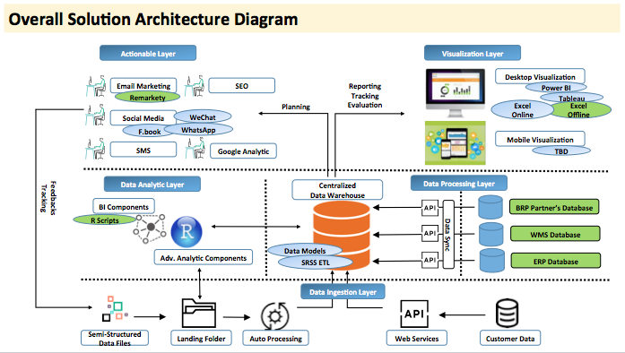
BUSINESS REJUVENATION PROGRAM
BRP

Slide 4











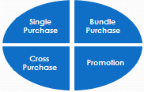
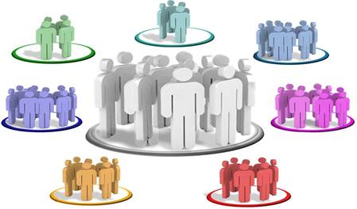
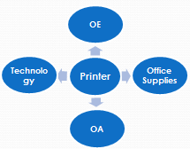






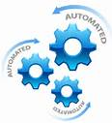

BUSINESS REJUVENATION PROGRAM
Actionable Layer
Visualization Layer
EDM
Report Tracking Evaluation
Desktop Visualization
Planning
Excel Online
Social Media
Excel Offline
Market Place
Mobile Visualization
Data Analytic Layer
Centralized Data Warehouse
Data Processing Layer
API
Retail Database
Website Database
API
Data Ingestion Layer
Semi-Structured Data Files
Landing Folder
Auto Processing
Web Services
Customer Data

Slide 5
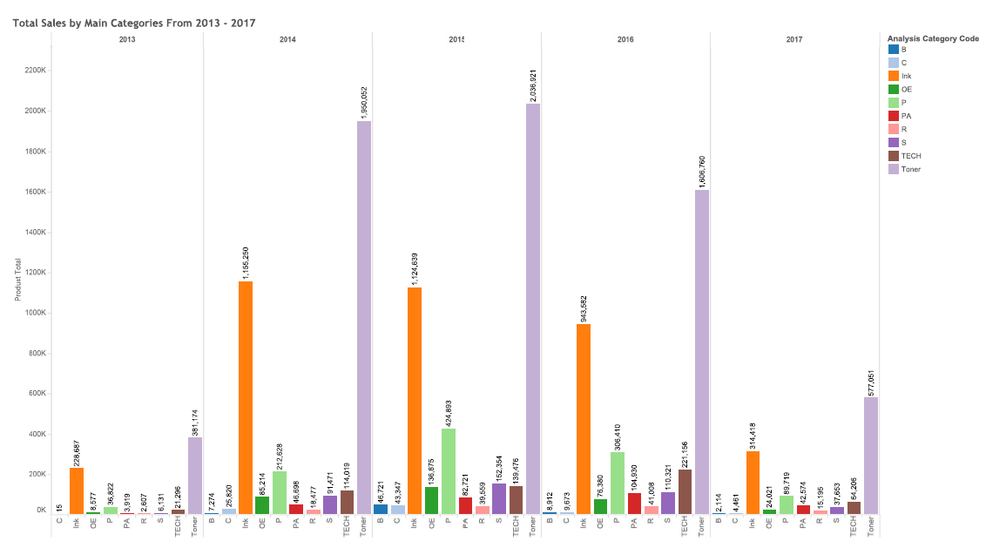
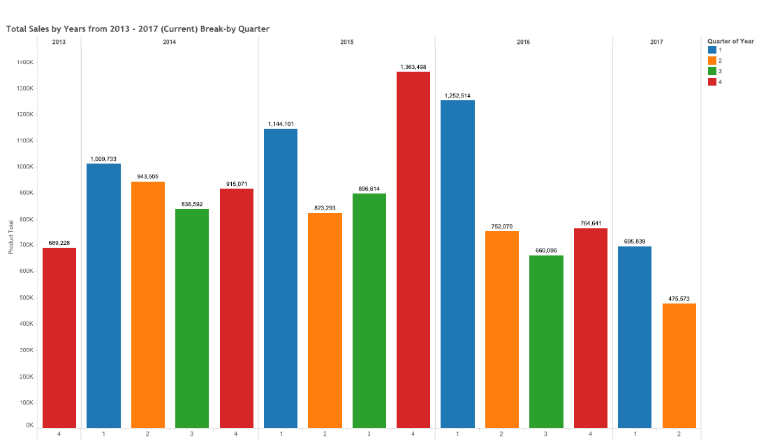
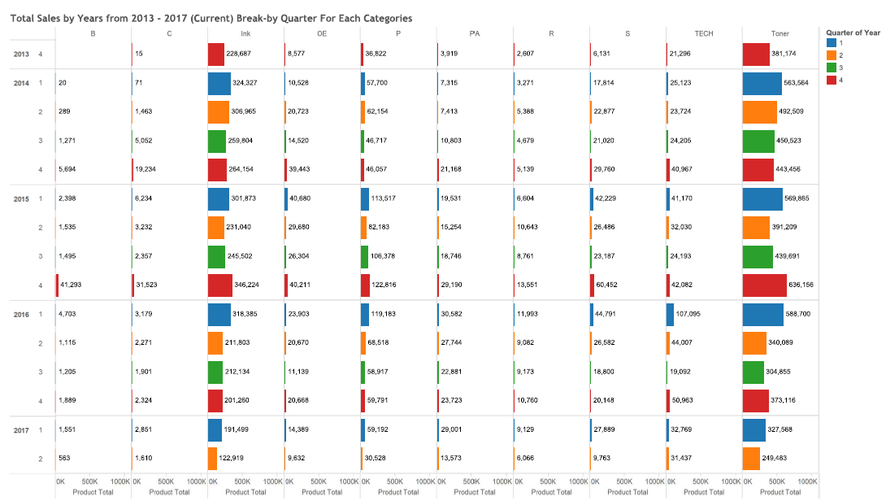
BUSINESS REJUVENATION PROGRAM
Actionable Layer
Visualization Layer
EDM
Reports Tracking Evaluation
Social Media
Planning
Market Place
Data Analytic Layer
Centralized Data Warehouse
Data Processing Layer
API
Retail Database
Website Database
API
API
Data Ingestion Layer
Tracking Data Files
Auto Process
Web Services
Customer Data

